Slide 1
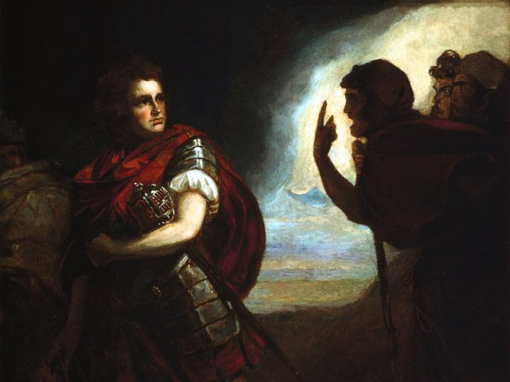
The Tragedy of Macbeth
Lesson 4

Slide 2
Activator- Poetry, Pentameters, and Pirates

Slide 3
Poetry, Pentameters, and Pirates

Slide 4
Hip-Hop and Shakespeare

Slide 5
Activity 1- Close Reading of 1.6

Slide 6
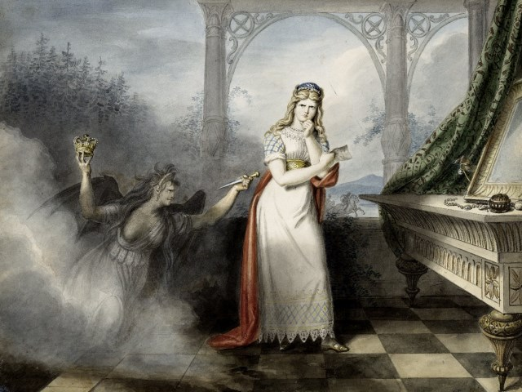
Discussion
How does Lady Macbeth treat the king? How is dramatic irony used here?

Slide 7
Theme Extension
Remember:
The witches stressed that fair is foul and foul is fair. How does Lady Macbeth reinforce this theme? Could she be who the witches were referring to when they said this?

Slide 8
Activity 2- Macbeth’s Motives Act 1, Scene 7 Lines 1-29

Slide 9
Macbeth’s Mindset
Video 1.7

Slide 10
Weighing his Options
Macbeth has many reasons for not killing the king. What are they?

Slide 11
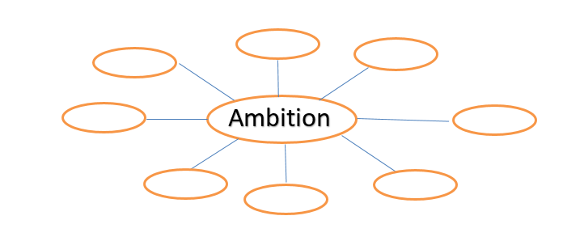
Vocabulary Spotlight

Slide 12
Activity 3- Close Reading of Remainder of 1.7

Slide 13
Text Analysis
How does Lady Macbeth convince Macbeth to kill the king?

Slide 14
Activity 4-Prepare for Writing Quiz

